Slide 1
Entrepreneurship
PRESENTATION 1
to the world of
Welcome

Slide 2

Entrepreneurship, is a skill and a talent that is grown.
However, not all have this skill due to many factors that contributes to this.
The goal in this analysis is to develop an algorithm that shall predict whether students have this skill.
The objective in this is to help: the school, parents, guardians, mentors and whomever responsible, in building and nurturing this skill that the student has. To help them achieve this and guide them in this beautiful journey to become the next Entrepreneur!

Slide 3
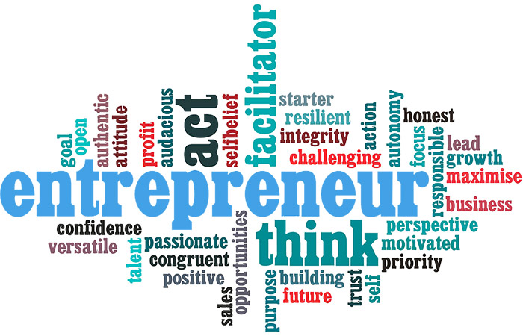
In This Project, We shall analyze key traits and factors that may be deemed as skills needed for an entrepreneur.
We shall obtain random student data from Progress University that will help us in the project.

Slide 4
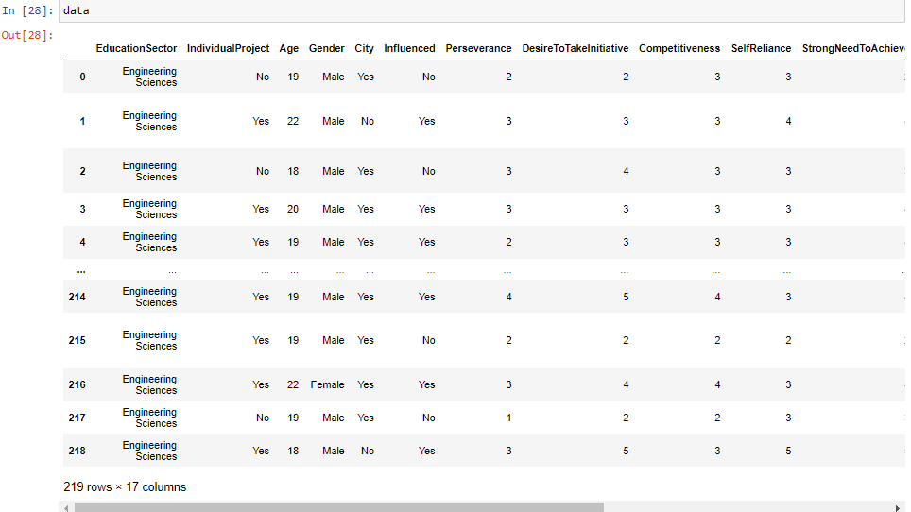
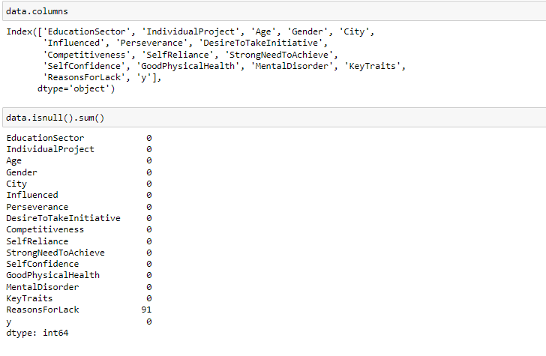
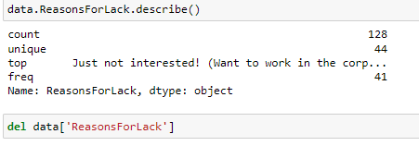
This is the data that we obtained from Progress University
Here below we can see the columns that we acquired.
In order to work with the data,
We had to clean it.

Slide 5
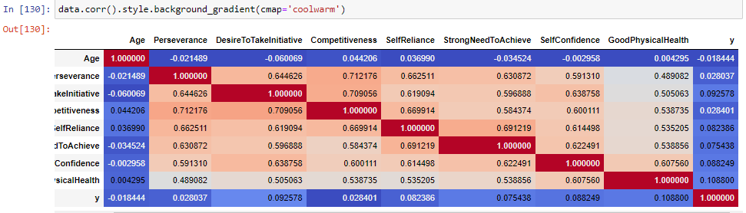
We also checked for correlation in the data.
The purpose of this is to identify and visualize patterns in the given data..

Slide 6
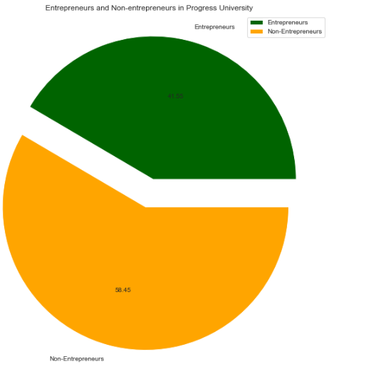
From the data collected in Progress University,
A (58.45%) are non-entrepreneurs
While a (41.55%) are entrepreneurs

Slide 7
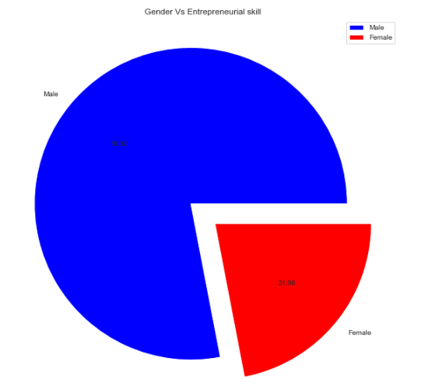
Distribution of the entrepreneur’s gender
From this pie-chart,
It is evident that a higher percentage of entrepreneurs are
Male (78.02%)
While the Females are at (21.08%)

Slide 8
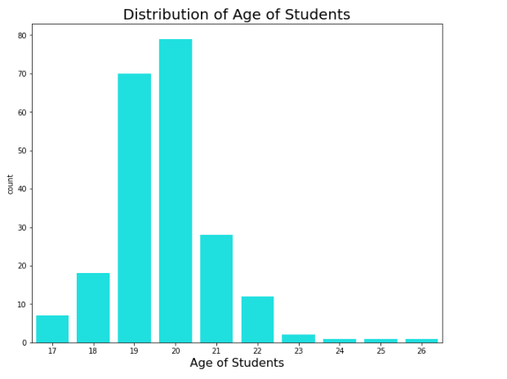
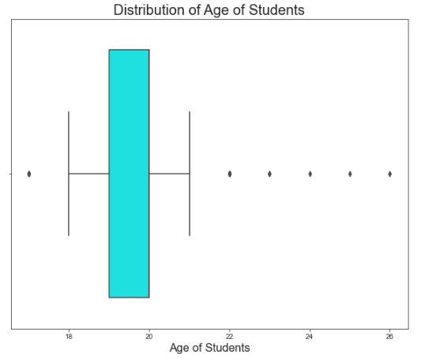
Distribution of students using Age.
From the graph,
Most of the students are at age 20.
It is also observed that there are several outliers using boxplot on our right. >>>

Slide 9
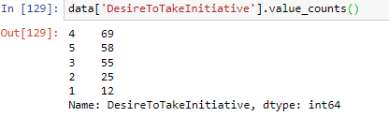
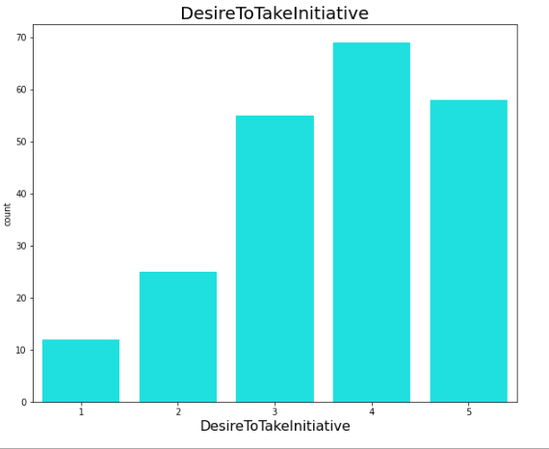
From this, we learn that a good percentage had the trait of initiation.
Only few had a ranking of 1/5
While most had a good
4/5

Slide 10
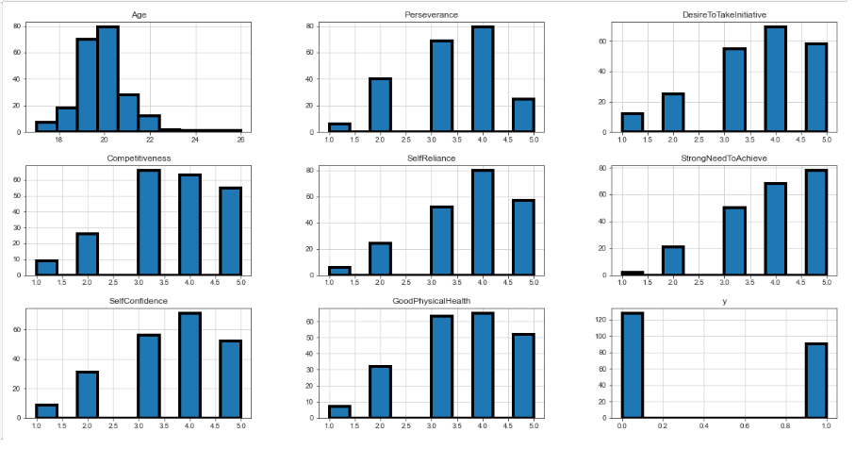
These are histograms that show the basic summary of the data-set.
Notes:
High percentage of the people were 20yrs
They were highly competitive
Boost of self-confidence
Most were self reliant
Had a strong need to achieve.

Slide 11
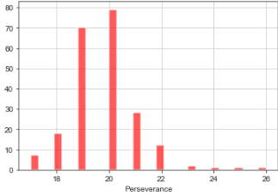
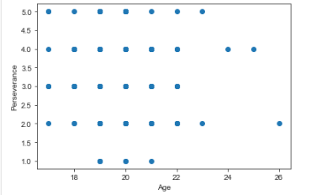
Despite having a few outliers, we can see from the plots above that people of the age 20, were more than the others.

Slide 12
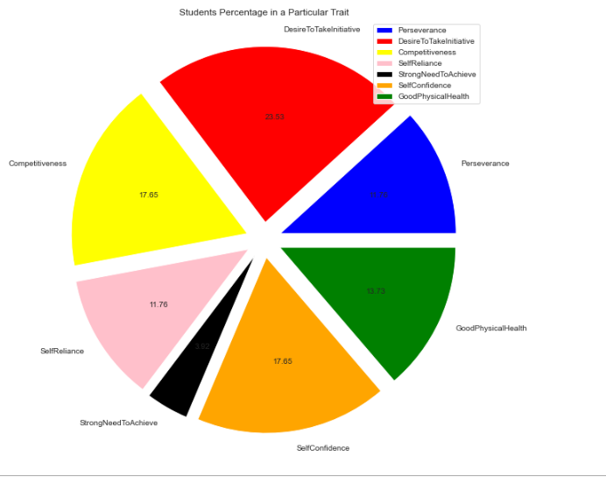
Desire to take initiative took the lead in the common character traits that the students had.
(23.53%)
Strong need to achieve, tailed the list having only a (3.92%) of the students.

Slide 13


As we now conclude with the first part of the project,
It is safe to say that, once you notice you have some of the traits, rather a close-friend, you may advice them to check on entrepreneurship.
Guardians and parents who notice this as well from their child, should help nurture their skills and talents.

Slide 14
The BIG QUESTION IS:
Do you have these traits!!!
Are you an
ENTERPRENEUR?!

Slide 15
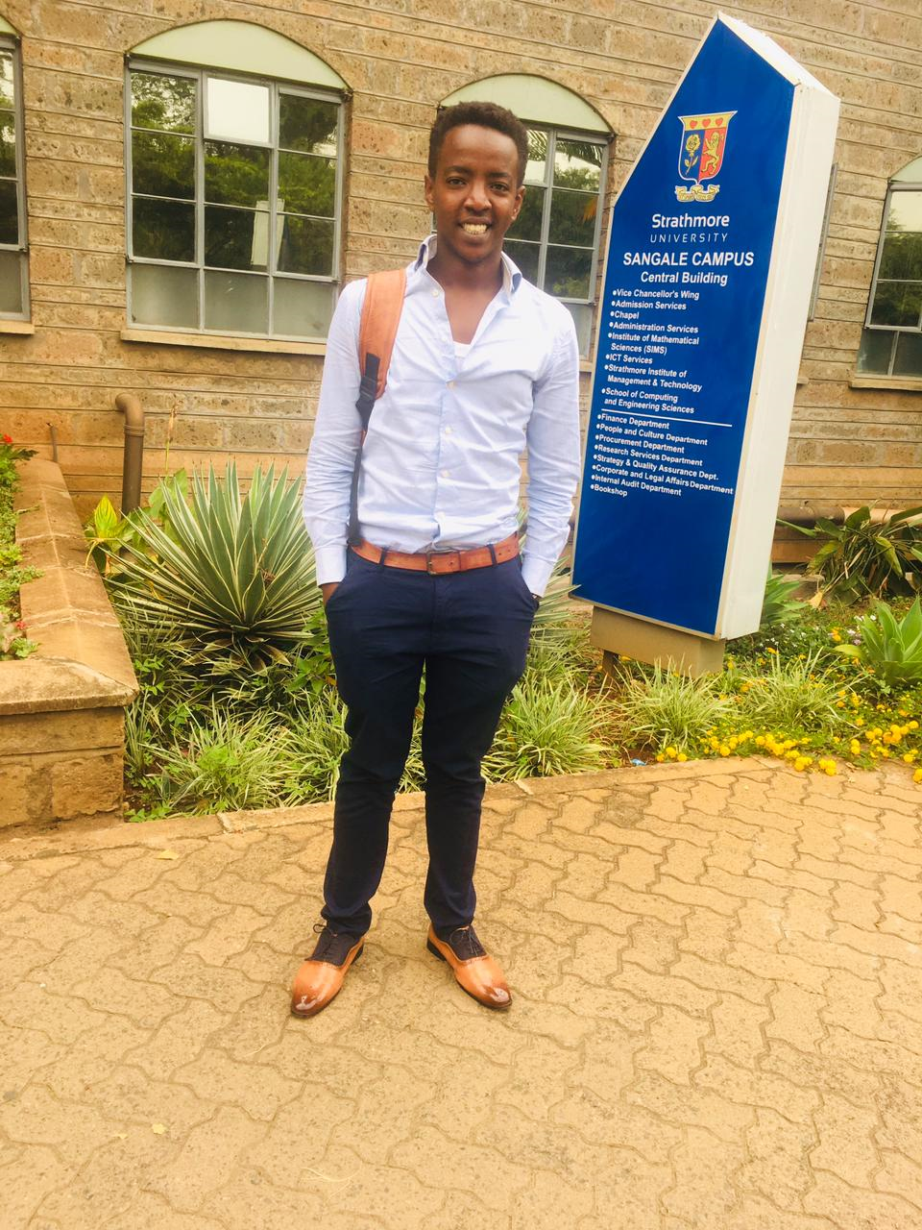
Mbugua Oliver Maichibu,
Entrepreneurship in Students.
This was Brought to you by:
Certified Data Scientist.
©2022

